Slide 1



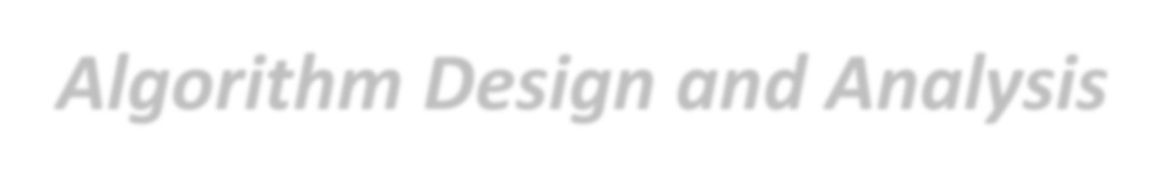

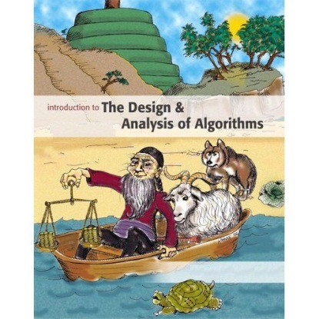



Introduction to
Algorithm Design and Analysis
[7] Selection
Yu Huang
http://cs.nju.edu.cn/yuhuang Institute of Computer Software Nanjing University

Slide 2

In the last class…
MergeSort
Design
Cost – time & space
Lower bounds for comparison-based sorting
Worst-case
Average-case

Slide 3

The Selection
Selection – warm-ups
Finding max and min
Finding the second largest key
Adversary argument and lower bound
Selection – select the median
Expected linear time
Worst-case linear time
A Lower Bound for Finding the Median

Slide 4



The Selection Problem
Problem definition
o Suppose E is an array containing n elements with keys from some linearly order set, and let k be an integer such that 1≤k≤n. The selection problem is to find an element with the k^{th} smallest key in E.
Special cases
o Find the max/min – k=n or k=1
Selection vs.
Searching
o Find the median (𝑘𝑘 = ^{𝑛𝑛})
2

Slide 5




Lower Bound of Finding the Max
For any algorithm 𝓐𝓐 that can compare and copy numbers exclusively, in the worst case, 𝓐𝓐 cannot do fewer than n-1 comparisons to find the largest entry in an array with n entries.
o Proof: an array with n distinct entries is assumed. We can exclude a specific entry from being the largest entry only after it is determined to be “loser” to at least one entry. So, n-1 entries must be “losers” in comparisons done by the algorithm. However, each comparison has only one loser, so at least n-1 comparisons must be done.

Slide 6


Decision Tree and Lower Bound
Since the decision tree for the selection problem must have at least n leaves, the height of the tree is at least ⎡logn⎤. It’s not a good lower bound.
A more powerful tool for analysis is necessary: adversary argument
Example: n=4
0:1
≤ <
1:2
0:2
2:3
1:3
……
3
2
3
1
There are more than n leaves! In fact, 2^{n-1} leaves at least.

Slide 7




Finding max and min
The strategy
Pair up the keys, and do n/2 comparisons(if n odd, having E[n] uncompared);
Doing findMax for larger key set and findMin for small key set respectively (if n odd, E[n] included in both sets)
Number of comparisons
o For even n: n/2+2(n/2-1)=3n/2-2
o For odd n: (n-1)/2+2((n-1)/2+1-1)=⎡3n/2⎤-2
Adversary
How to prove this lower bound?
Argument !

Slide 8

Unit of Information
Max and Min
That x is max can only be known when it is sure that every key other than x has lost some comparison.
That y is min can only be known when it is sure that every key other than y has win some comparison.
Each win or loss is counted as one unit of information
Any algorithm must have at least 2n-2 units of information to be sure of specifying the max and min.

Slide 9

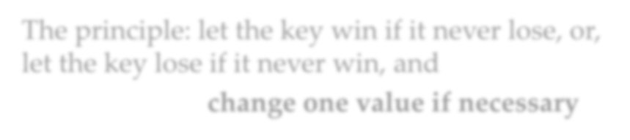


Adversary Strategy
Status of keys x and y Compared by an algorithm | Adversary response | New status | Units of new information
N,N | x>y | W,L | 2
W,N or WL,N | x>y | W,L or WL,L | 1
L,N | x<y | L,W | 1
W,W | x>y | W,WL | 1
L,L | x>y | WL,L | 1
W,L or WL,L or W,WL | x>y | No change | 0
WL,WL | Consistent with | No change | 0
 | Assigned values
The principle: let the key win if it never lose, or, let the key lose if it never win, and
change one value if necessary

Slide 10


Lower Bound by Adversary Strategy
Construct an input to force the algorithm to do more comparisons as possible
To give away as few as possible units of new information with each comparison.
It can be achieved that 2 units of new information are given away only when the status is N,N.
It is always possible to give adversary response for other status so that at most one new unit of information is given away, without any inconsistencies.
So, the Lower Bound is n/2+n-2(for even n)

Slide 11









An Example
x₁ x₂ x₃ x₄
S V S V S V S V
x₅
x₆
Comparison
S V S V
x1,x2
W Now20, x₃ isLthe o1n0ly
N * N * N * N *
one which never
L 5
x1,x5
^{W} lo ²⁰ so, Max is x
ses,
3
W 15 L
No₈w, x₄ is the only
x3,x4
one which never
8 co m^{W}pa¹r⁵isonwsi!ns, so, x₄ is Min
x3,x6
L 12
x3,x1
WL
²T⁰ he lowe^{W}r b²o⁵ und is 7.
WL 10 L 8
x2,x4
x₅x₆
WL 5 L 3
x6,x4
L 2
Raising/lowering the value according to strategy
WL 3

Slide 12



Find the 2nd Largest Key
Brute force - using FindMax twice
Need 2n-3 comparisons.
For a better algorithm
Collect some useful information from the first FindMax
Observations
The key which loses to a key other than max cannot be the 2nd largest key.
To check “whether you lose to max?”

Slide 13






Tournament for the 2nd Largest Key
The length of the longest path is
⎡logn⎤ , as many as those compared to max at most.
Larger key bubbles up
2
2
6
x₂ is max
Only x₁, x₃, x₅, x₆ may be the second largest key.
2
5
6
9
2
3
4
5
6
7
8
9
1
2

Slide 14


Analysis of Finding the 2nd
Any algorithm that finds secondLargest must also find max before. (n-1)
The secondLargest can only be in those which lose directly to max.
On its path along which bubbling up to the root of tournament tree, max beat ⎡lgn⎤ keys at most.
Pick up secondLargest (⎡logn⎤ -1)
Total cost: n+ ⎡logn⎤-2

Slide 15

Lower Bound by Adversary
Theorem
Any algorithm (that works by comparing keys) to find the second largest in a set of n keys must do at least n+⎡logn⎤-2 comparisons in the worst case.
Proof
There is an adversary strategy that can force any algorithm that finds secondLargest to compare max to
⎡logn⎤ distinct keys.

Slide 16


Weighted Key
Assigning a weight w(x) to each key
o The initial values are all 1.
Adversary strategy
Note: for one comparison, the weight increasing is no more than doubled.
Case
Adversary reply
Updating of weights
w(x)>w(y)
w(x)=w(y)>0
w(y)>w(x)
w(x)=w(y)=0
x>y x>y y>x
Consistent with previous replies
w(x):=w(x)+w(y); w(y):=0
w(x):=w(x)+w(y); w(y):=0
w(y):=w(x)+w(y); w(x):=0
No change
Zero=Loss

Slide 17


Lower Bound by Adversary: Details
Note: the sum of weights is always n.
Let x is max, then x is the only nonzero weighted key, that is w(x)=n.
By the adversary rules:
w_{k}(x)≤ 2w_{k-1}(x)
Let K be the number of comparisons x wins against previously undefeated keys:
n=w_{K}(x)≤2^{K}w₀(x)=2^{K}
So, K≥⎡logn⎤

Slide 18


Tracking the Losers to MAX
x₈
To be filled with winners
Building a heap structure of 2n-1 entries, using n-1 extra space
x₈
x₈
x₈
x₁
x₂
x₃ x₄ x₅ x₆
x₇
x₈
x₉
^{x}10
n entries in input

Slide 19


Finding the Median: the Strategy
Observation
If we can partition the problem set of keys into 2 subsets: S1, S2, such that any key in S1 is smaller that that of S2, the median must located in the set with more elements.
Divide-and-Conquer
Only one subset is needed to be processed recursively.

Slide 20

Adjusting the Rank
The rank of the median (of the original set) in the subset considered can be evaluated easily.
An example
Let n=255
The rank of median we want is 128
o Assuming |S₁|=96, |S₂|=159
Then, the original median is in S₂, and the new rank is 128-96=32

Slide 21














Partitioning: Larger and Smaller
Dividing the array to be considered into two subsets: “small” and “large”, the one with more elements will be processed recursively.
A “bad” pivot will give a very uneven partition!
[splitPoint]:
pivot
for any element in this segment, the key is less than pivot.
small
To be
large
for any element in this segment, the key is not less than pivot.
p rocessed
recursively

Slide 22


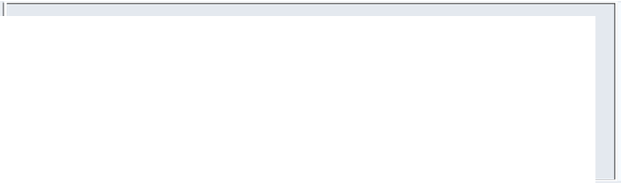
Selection: the Algorithm
Input: S, a set of n keys; and k, an integer such that 1≤k≤n.
Output: The kth smallest key in S.
Note: Median selection is only a special case of the algorithm, with k=⎡n/2⎤.
Procedure
Element select(SetOfElements S, int k)
o if (|S|≤5) return direct solution; else
o Constructing the subsets S₁ and S_{2;}
Key issue:
How to construct the
partition ?
o Processing one of S₁,S₂ with more elements, recursively.

Slide 23
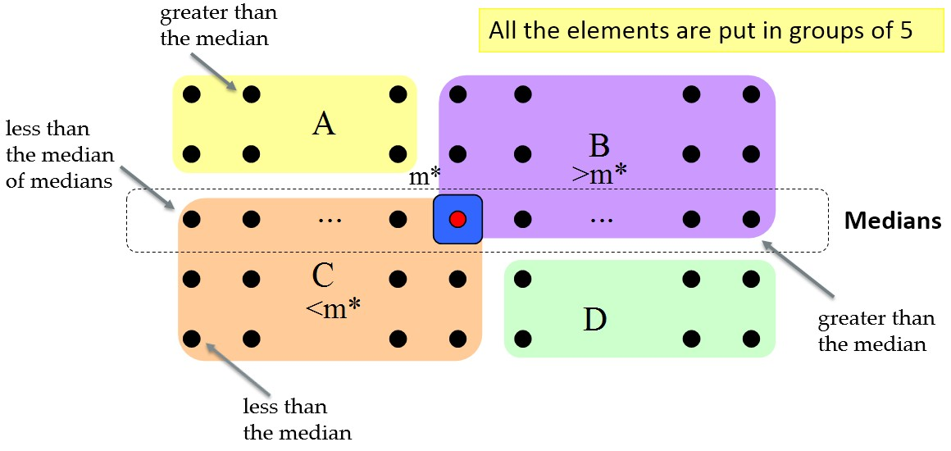
Partition improved: the Strategy

Slide 24

Constructing the Partition
Find the m*, the median of medians of all the groups of 5, as illustrated previously.
Compare each key in sections A and D to
m*, and
Let S₁=C∪{x|x∈A∪D and x<m*}
Let S₂=B∪{x|x∈A∪D and x>m*}
(m* is to be used as the pivot for the partition)

Slide 25

Divide and Conquer
if (k=|S₁|+1) return m*;
else if (k≤|S₁|)
return select(S₁,k); //recursion else
return select(S₂,k-|S₁|-1); //recursion

Slide 26


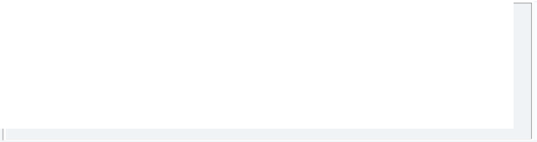





Analysis
For simplicity:
o Assuming n=5(2r+1) for all calls of select.
•
W (n) ≤ 6^{⎛ n ⎞} + W ^{⎛ n ⎞} + 4r + W (7r + 2)
The extreme case: all the elements in A∪D in one subset.
⎜ ₅ ⎟ ⎜ ₅ ⎟
⎝ ⎠ ⎝ ⎠
Comparing all the elements in A∪D with m*
Finding the median in every group of 5
Finding the median of the medians
Note: r is about n/10, and 0.7n+2 is about 0.7n, so
W (n) ≤ 1.6n + W (0.2n) + W (0.7n)

Slide 27



Worst Case Complexity of Select
W(n) 1.6n
1.6n
W(.2n)
1.6(.2n)
W(.7n)
1.6(.7n)
1.6(. 9)n
1.6(. 81)n
W(.04n) 1.6(.04n)
W(.14n) 1.6(.14n)
W(.14n)
1.6(.14n)
W(.49n)
1.6(.49n)
1.6(. 9)³n
W(.2³n) | W(.2²(.7)n) | W(.2²(.7)n) | W(.2(.7)²n) | W(.2²(.7)n) | W(.2(.7)²n) | W(.2(.7)²n) | W(.2³n)
Note: Row sums is a decreasing geometric series, so
W(n)∈Θ(n)

Slide 28

Relation to Median
Observation
o Any algorithm of selection must know the relation of every element to the median.
y
Median
y
The adversary makes you wrong in either case

Slide 29

Crucial Comparison
A crucial comparison
Establishing the relation of some x to the median.
Definition (for a comparison involving a key x)
Crucial comparison for x: the first comparison where
x>y, for some y≥median, or x<y for some y≤median
Non-crucial comparison: the comparison between x
and y where x>median and y<median

Slide 30

Adversary for Lower Bound
Status of the key during the running of the Algorithm:
L: Has been assigned a value larger than median
S: Has been assigned a value smaller than median
N: Has not yet been in a comparison
Adversary rule: Comparands
Adversary’s action
N,N L,N or N,L S,N or N,S
one L, the another S change N to S change N to L
(In all other cases, just keep consistency)

Slide 31


Notes on the Adversary Arguments
All actions explicitly specified above make the comparisons un-crucial.
At least, (n-1)/2 L or S can be assigned freely.
If there are already (n-1)/2 S, a value larger than median must be assigned to the new key, and if there are already (n-1)/2 L, a value smaller than median must be assigned to the new key. The last assigned value is the median.
So, an adversary can force the algorithm to do (n-1)/2 un-crucial comparisons at least(In the case that the algorithm start out by doing (n-1)/2 comparisons involving two N.

Slide 32


Lower Bound for Selection Problem
Theorem:
Any algorithm to find the median of n keys(for odd n) by comparison of keys must do at least 3n/2-3/2 comparisons in the worst case.
Argument:
There must be done n-1 crucial comparisons at least.
An adversary can force the algorithm to perform as many as (n-1)/2 uncrucial comparisons.
Note: the algorithm can always start out by doing (n-1)/2 comparisons involving 2 N-keys, so, only (n-1)/2 L or S left for the adversary to assign freely as the adversary rule.

Slide 33




Thank you!
Q & A
Yu Huang
http://cs.nju.edu.cn/yuhuang

